Slide 1


Introduction to R
Jordan Creed, MPH
Department of Cancer Epidemiology
Moffitt Cancer Center
Jordan.H.Creed@moffitt.org
jhcreed

Slide 2
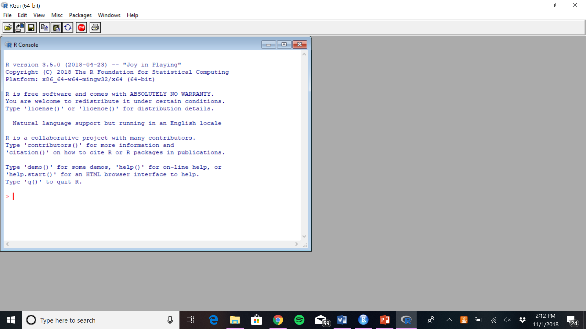
R is a language and program for statistical analysis
Data analysis
Data management and manipulation
Data visualization
Documentation
Dissemination

Slide 3
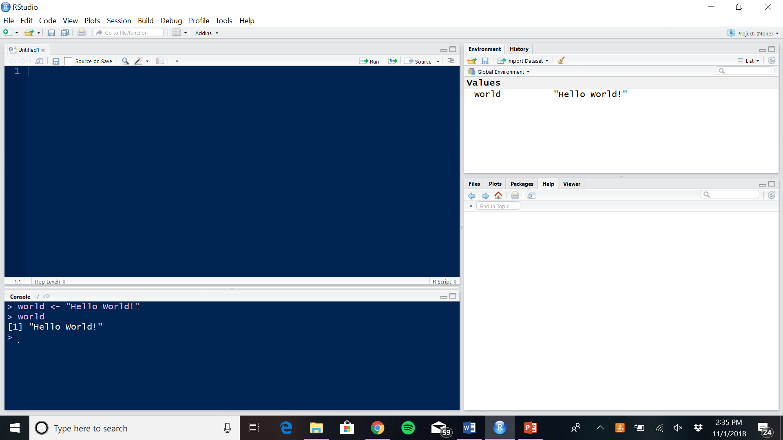

RStudio is a free integrative development environment (IDE) for R
Auto-fills variable names
Shows elements in the environment
Stores plots to easily move between
Point and click options

Slide 4

FREE
Need stronger grasp on coding language
Advancements released almost immediately
Free-for-all advancements
Who you work for
Easier to manipulate graphics
$$$
More conversational
Advancements released with the next release
Well-tested advancements
Who you work for
Better looking graphics to start with

Slide 5
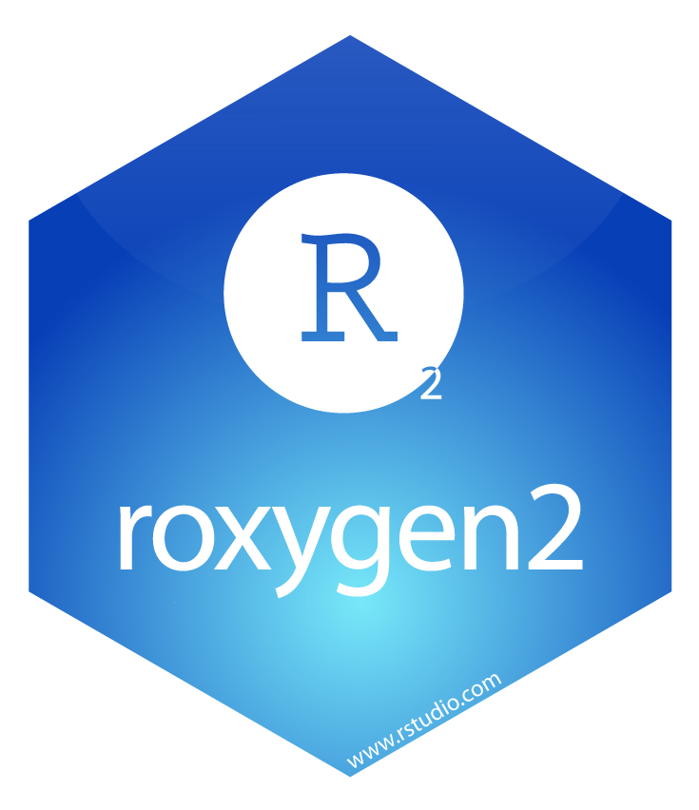
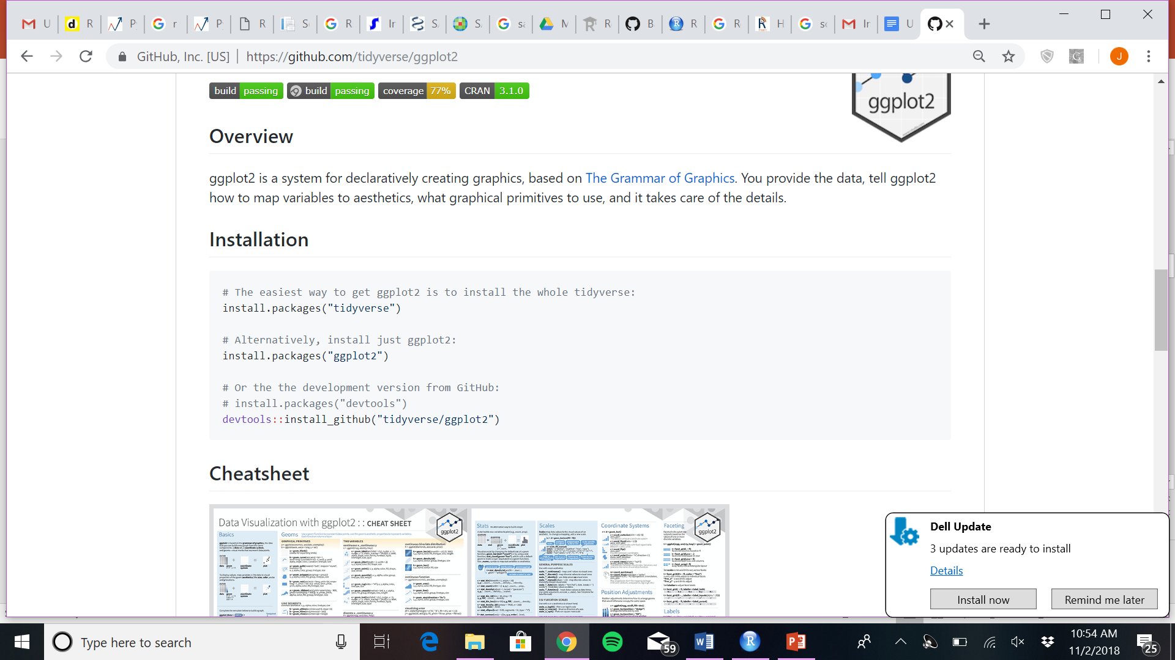
Packages: units of reproducible code
Macros in SAS or Libraries in python
Available from: CRAN, GitHub, BioConductor, …
Make your own

Slide 6

The Tidyverse
AKA the Haldeyverse
The core packages: ggplot2, dplyr, tidyr, readr, purr, tibble, stringr, forcats
Much more …
Collection of packages with the same “philosophy, grammar, and data structures”

Slide 7
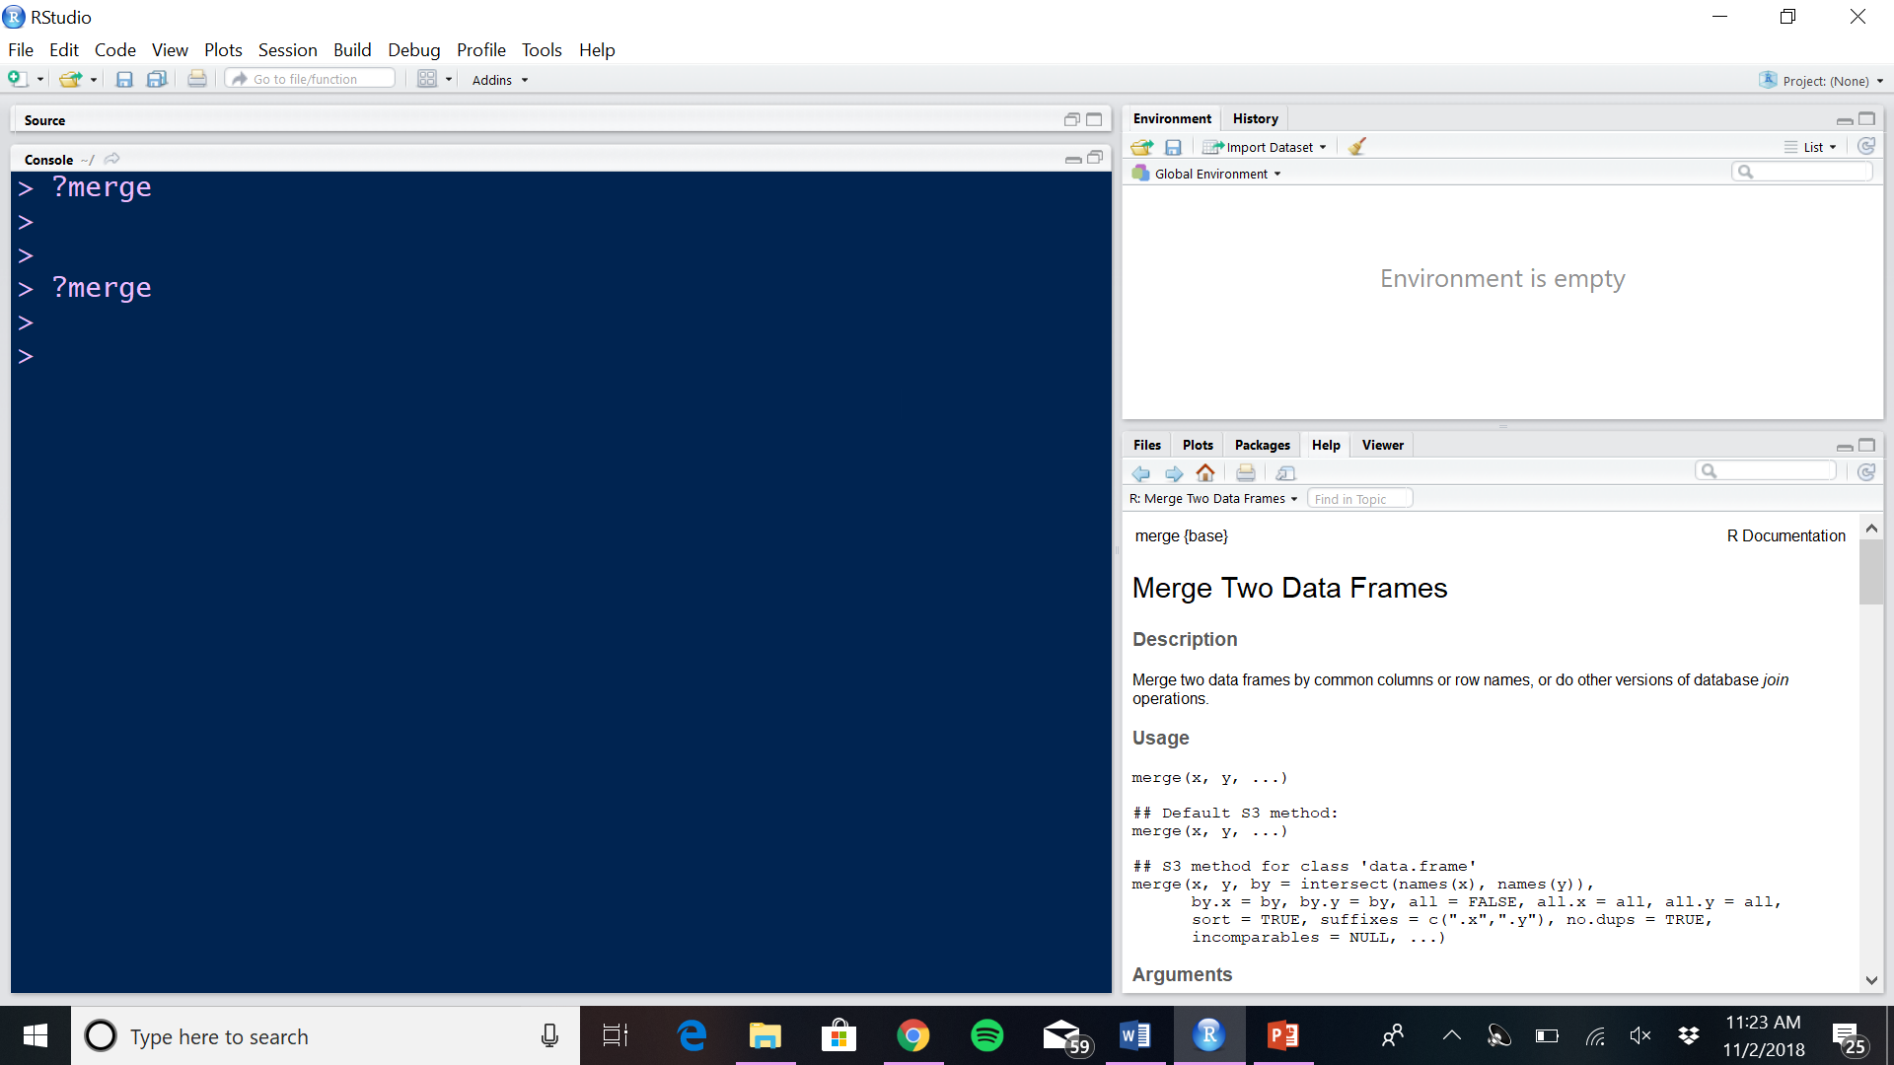
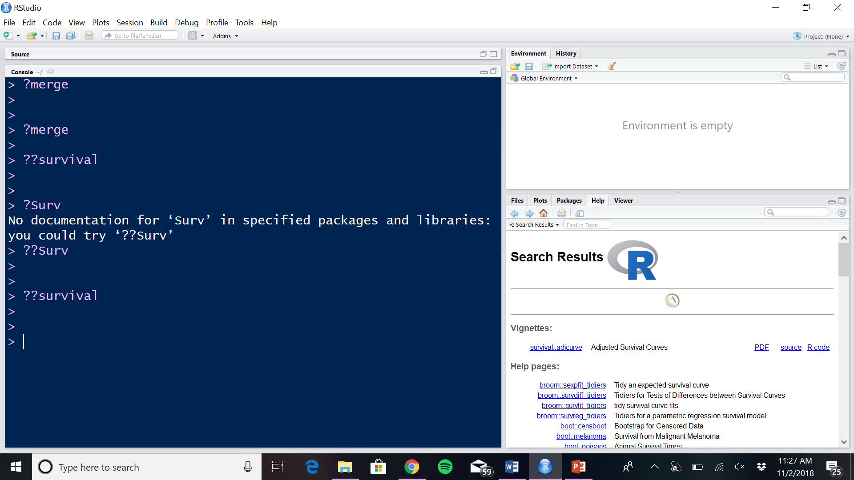
Help within R

Slide 8
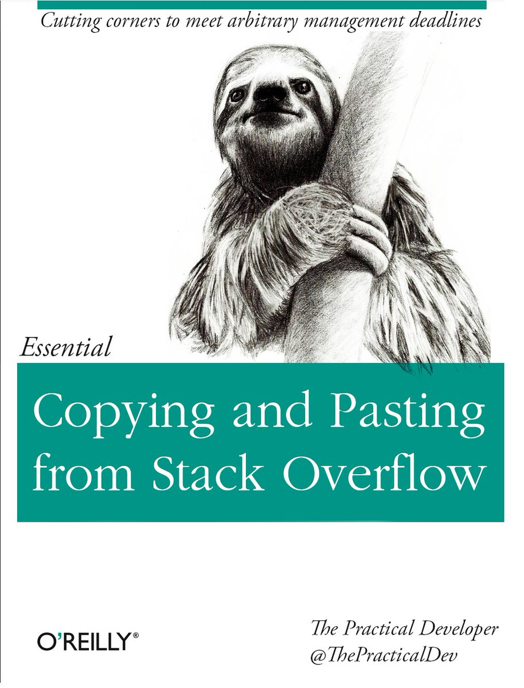
Help outside of R:
Stack Overflow
https://stackoverflow.com/questions/1744861/how-to-learn-r-as-a-programming-language
RStudio Community (literally)
https://community.rstudio.com/
GitHub
https://github.com/GerkeLab/xCellCalls

Slide 9





R integration
Just to name a few …
Notes:
Haven – import sas, stata, and spss data files
Reticulate – integrate R with python (run python chunks in a python session in an R session)
BERT – run R functions in excel spread sheets
Tableau – you can run R scripts from within tableau if so inclined
Google – multiple packages such as Rgooglemaps (uses google maps to overlap data and provides an interface for query map stats) and google sheets (access and manage google sheets from inside R)

Slide 10




Dissemination
Notes:
RPubs, a free service that makes it easy to publish documents to the web from R
Shiny is an R package that makes it easy to build interactive web apps straight from R.
Rmarkdown makes reproducible documents
Bookdown for making books and technical documents

Slide 11
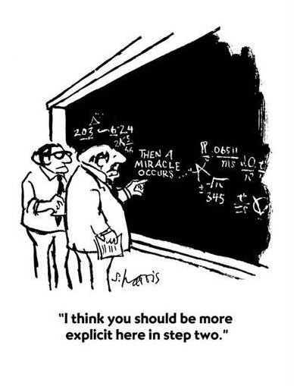
Reproducible Research
Statistical reproducibility
Prove results
Avoid issues such as p-hacking
Computational reproducibility
Use the same program and methods
Allows others to reuse and build upon

Slide 12

What is GitHub?
Code hosting platform
Used for version control and code sharing
Resources for GitHub:
https://guides.github.com/
https://git-scm.com/book/en/v2 (ProGit)
Why do we care?
Packages
Example code
Data
Citable repros

Slide 13

Best Practices
Comment your code
Consistent formatting and naming
Code grouping
Short and simple

Slide 14
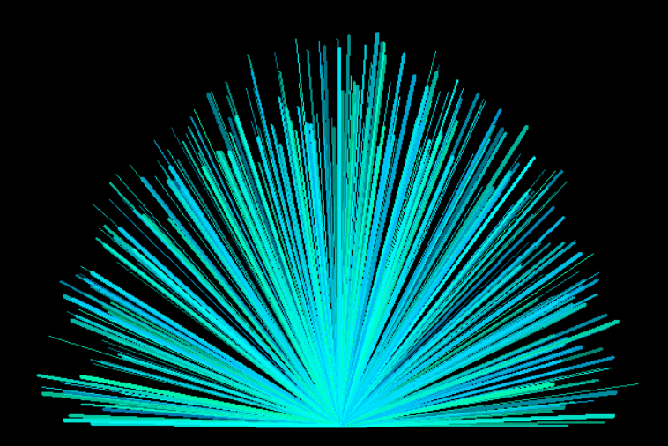
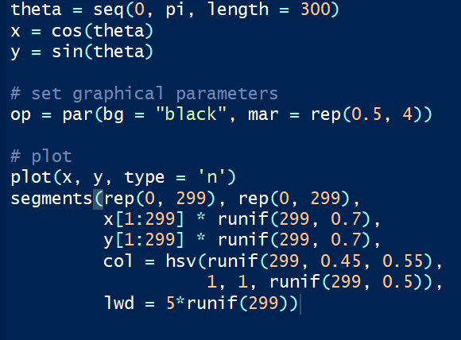
Art with R

